Slide 1

Finding Primes

Slide 2
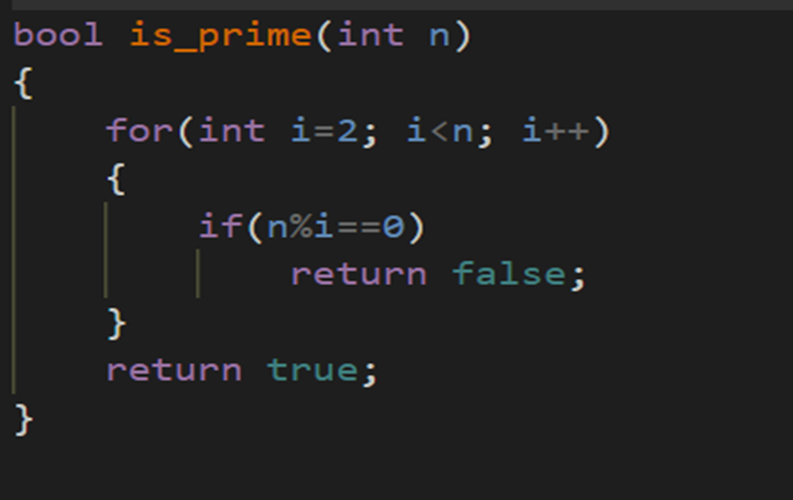

Check if a given number is a prime in $O\left(n\right):$

Slide 3

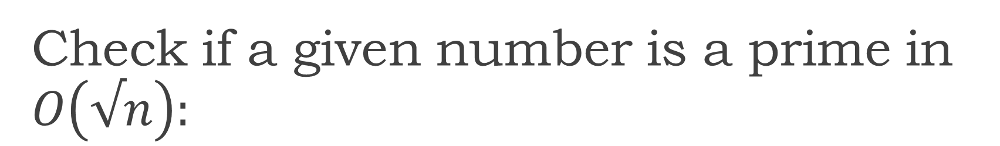
Check if a given number is a prime in $O\left(√n\right):$
Let N be given number and a be a factor of N :
$a×b=N$
if
$a≤b$
then
$a≤\sqrt{N}$
$b≥\sqrt{N}$

Slide 4
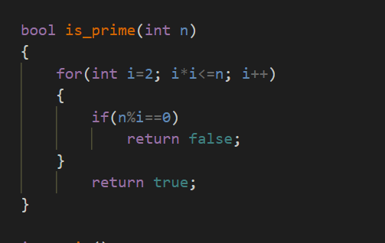
Continued….

Slide 5
Sieve:
Find all the prime numbers that are less than or equal to a given number N or to find out whether a number is a prime number.

Slide 6
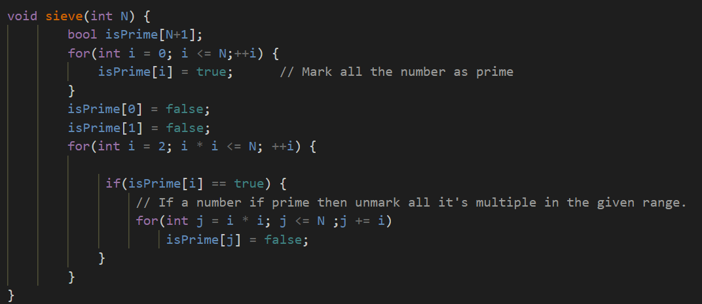
Continued…

Slide 7
Complexity analysis
Refer: https://cp-algorithms.com/algebra/sieve-of-eratosthenes.html

